Slide 1
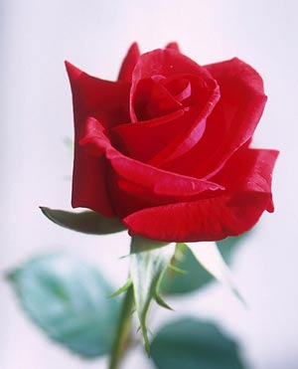
WELCOME

Slide 2
Presented by:
Najmun Nahar
Assistant teacher
Dashgharia Govt. Primary School
Chatkhil, Noakhali.

Slide 3

Lesson introduction:
Class : Two
Subject : English
Lesson : Rainbow
Lesson unit: ( I see …. a view)
Page : 28
Time : 40 minutes

Slide 4


l
Learning outcomes
Students will be able -
to enjoy and understand the rhyme.
to recite the rhyme with correct pronunciation after the teacher.
3. to understand simple question about the colours and answer them.

Slide 5
Create emotion
Time: 2 minutes
by song (we shall …… some day)

Slide 6
Which colour is it?
violet

Slide 7

What colour is it?
blue

Slide 8
Which colour is it ?
indigo

Slide 9

What colour is it?
green

Slide 10
What’s colour is it?
yellow

Slide 11
Which colour is it?
orange

Slide 12
Which colour is it?
red

Slide 13

Rainbow

Slide 14
We have seen some colours. They are seven colours of rainbow.
violet
blue
indigo
green
yellow
orange
red

Slide 15

Teachers recitation:
I see red and orange,
Yellow,green and blue.
Violet,indigo too.
What a view!

Slide 16



Students recitation with correct pronunciation.
Small group work

Slide 17
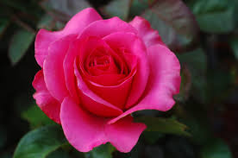
Evuluation
Time : 15 minutes

Slide 18
Small group work:
Time : 8 minutes
recite the rhyme

Slide 19
Pair work
Time : 7 minutes
answer the question:

Slide 20

There are three pictures.
Can you say which colour is this ?
red

Slide 21
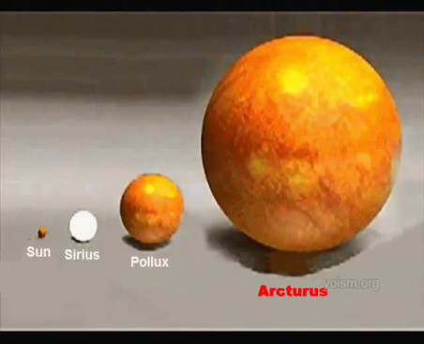
There is an orange in the picture.
Which colour is it?
orange

Slide 22




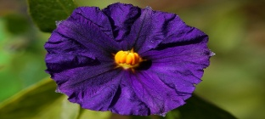
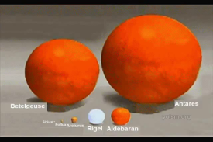
Matching pictures with colours name.
red
yellow
green
indigo
violet
orange
blue

Slide 23
Good bye

